Slide 1
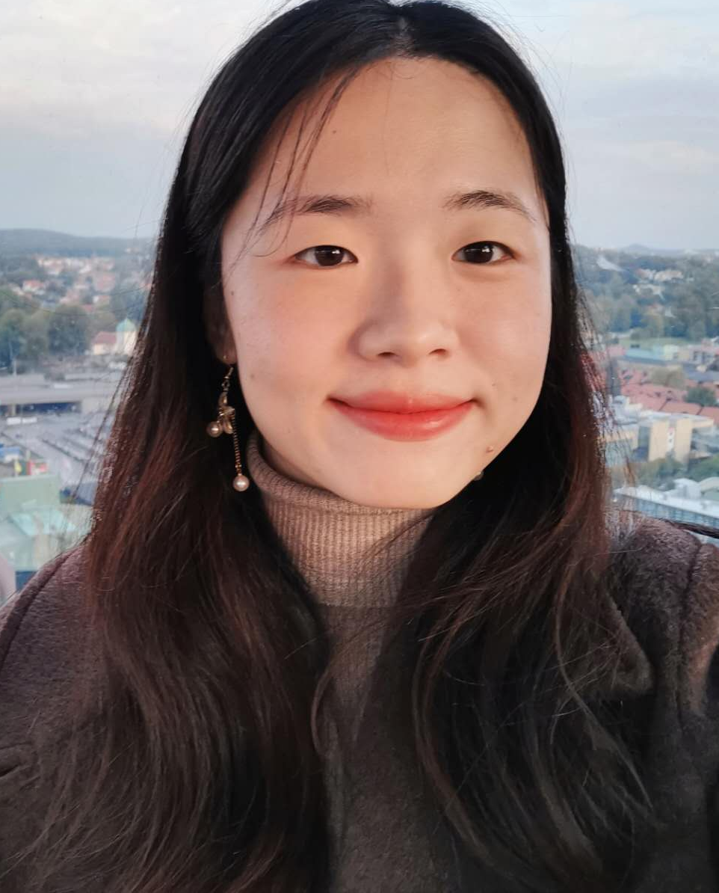
Xingrong Zong
Software Technology
Summary
I am a friendly, highly motivated, and results-driven individual with a robust foundation in software technology.
I am currently dedicated to advancing my knowledge and skills in frontend development, with a particular focus on web security.
I have studied in Sweden and China.
I have a permanent residence permit in Sweden.
Work Experiences
Göteborgs Stad - Kultursommarjobb
Portraitist| Jul 2019 – Aug 2019
SSP The Food Travel Experts - Universeum
Cashier | Jun 2019 – Sep 2019
Svensk Direktreklam
Advertisement Delivery | Apr - Jun 2017
TTS Marine AB
Summer Cleaning Staff | Aug 2016, 2017
Educational History Jensen Yrkeshögskola
Frontendutvecklare inrikning webbsäkerhet | Sep 2023 – 2025
Frontend Development Client
Basic JavaScript Programming
Frontend Development Server
Secure Communication over the Internet
Web Framework for JavaScript
Agile Project Methodology and Testing
Advanced Web Development with JavaScript
Packaging, Delivery and Follow-up
Web Security: Analysis and Implementation
Copenhagen Universitet
Exchange Study | Sep 2021 – Juni 2022
Independent courses in Machine Learning, focusing on Deep Learning
ronazong.work@gmail.com
linkedin.com/in/ronazong
github.com/RonaZong
0761-66 52 46
Ebbe Lieberathsgatan 33B
41265 Gothenburg

Slide 2
Xingrong Zong
Linnaeus University
Software Technology | Sep 2019 – Sep 2023
Computer Science as main area, focuses on programming and software in IT-system
Extra courses in mathematics
Uppsala University
Computer Science| Sep 2018 – Jan 2019
Independent courses in Computer Science
Skills
Communication Skills
Active Listening
Interpersonal Communication
Punctuality
Problem-Solving
Flexibility
Patience
Collaboration
Computer Skills
Java
JavaScript
HTML & CSS
Python
Adobe Photoshop, Illustrator
Inventor
Fusion 360
Microsoft Word, Excel, ...
Google Colab, Docs, ...
Language English - Advanced Swedish - Intermediate (SAS2) Mandarin - Native
References Be provided on request.
ronazong.work@gmail.com
linkedin.com/in/ronazong
github.com/RonaZong
0761-66 52 46
Ebbe Lieberathsgatan 33B
41265 Gothenburg

